Slide 1
Interactive “Simon-Says” Piano Game
Adam Ikner CIM 540 Midterm Project

Slide 2
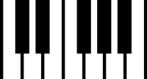
The game is essentially based off a simple piano graphic like the one above—transparent image to allow for manipulation. The premise of the game is similar to other classic
“simon-says” games.

Slide 3
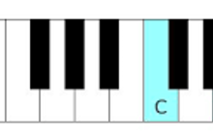
One at a time, a single key on the piano will be highlighted a certain color, and the user must memorize and repeat the pattern by hitting the same letter key on the computer’s keyboard in the same order. Each time the user repeats the pattern, an additional key/note will be added to the end.
Ex: C –– C + D –– C + D + E –– C + D + E + F

Slide 4
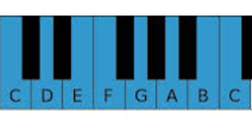
If the user plays back the incorrect pattern, then something will indicate that they messed up, and they can restart the game.
Ideas for indicating the wrong pattern: All the keys light up, there is an error tone, combination of both

Slide 5

Ideas for advancement or “failing epicly”
When the piano lights up a certain key, the same pitch/note associated with that key also plays
Instead of the piano playing random notes/keys, the order can be a simple song to increase enjoyment of the game
Have multiple keys played at the same time so the user can add harmony to the melody and increase difficulty

